Slide 1
Type of Learner
By: Wesley Pears

Slide 2
Visual/Verbal
I learned that I have a Visual/ Verbal Learning Style. I learn best when people write down and talk about what we are doing. I also benefit from being in a quiet place where I can read my text book, that is the easiest way for me to learn and focus. I like it when teachers write down the essential information on the board but they also talk about what they wrote down and add additional detail about what they are talking about. It also helps for me to copy down key information in my notes so I can see what I learned that day.

Slide 3
Points That Relate To Me
tend to sit in the front
often close their eyes to visualize or remember something
like to see what they are learning
are attracted to written or spoken language rich in imagery
prefer stimuli to be isolated from auditory and kinesthetic distraction
acquire knowledge by reading aloud
remember by verbalizing lessons to themselves (if they don't they have difficulty reading maps or diagrams or handling conceptual assignments like mathematics).
find reasons to tinker or move when bored

Slide 4
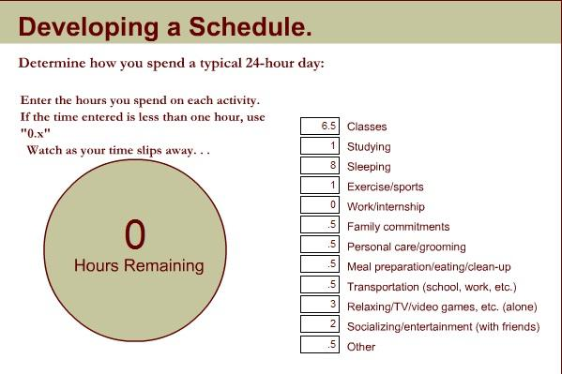
Time Management
How I Spend My Time

Slide 5
How I Spend My Time
By developing my schedule, I have realized that I spend most of my time in class at school and sleeping. This is really good because school is very important and so is sleep. These two things will help me succeed in life. Then in third place is relaxing, I think I spend a good amount of time relaxing because after school for 6.5 hours, you need some time to relieve stress. But I should spend more time studying because 1 hour is not enough to cover and memorize everything. I also socialize with friends for about 2 hours a day which means I'm not antisocial and I'm not a loner. Yay!

Slide 6
Study NO-NO's
Last Minute Cramming
This relates to me because whenever I have homework, test project etc. I normally do the majority of it the last day which causes a lot of pressure and stress so I don't do my work as well as I could. To fix this I should study every day before the test, don't cram into one night because it causes stress. If I needed to cram it then I should at least study two days prior.
Multi-Tasking
This relates to me because I tend to do other things when I study. I normally go on the computer, watch TV etc. I do something to relieve the boringness of studying. To fix this I should drop everything I'm doing for that day and only focus on studying. I should stay away from the computer so I don't get tempted to go on it.
Too much Music
Sometimes I listen to music when I study because I thought it helped me get away from everything else so I can simply study but all it did was distract me. I should not listen to music when I am studying because it is a distraction for the brain. But if I have to I should only listen to one genre, the best one would be classical.
Eating
I tend to go to the fridge a lot during studying so I can find food to fill my stomach. But it makes me zone out of studying so I can walk away and get food. To fix this, if I get hungry when I am studying, I should always keep a bag of chips, granola bar etc. beside me so I don’t have to interrupt my studying by getting food.
Bad Environment
I normally sit in my living room when I am studying but it’s a really bad place because I can get distracting by the TV and all the sounds from my kitchen. So my brain can't focus properly. I am normally sitting in an awkward position as well which doesn't help me. I should find a room that has peace and quiet where I can really focus on my studies with no distractions. This place should have a comfortable place to sit down.

Slide 7
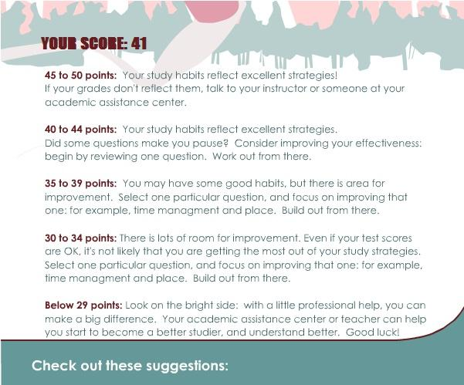
YES-YES!!!
Put first things first
I should put school work before games, Facebook, and Youtube because school is much more important and it should be my number one priority. If I put homework first I would have more time to go on Facebook etc. and I would have a better sleep.
Discover your key productivity periods and places
I should find out the time and place where I can study without distraction and I can focus on my work and where I can remember what I studied the next day. A good place would be my room right after school because my brain is still thinking right after school.
Look to continually challenge yourself
I should challenged myself to get a certain mark on a test so I will study harder and better to get to that goal mark on my test.
Look for better solutions to problems
If I don't understand something I can read around the thing I don't understand so I can gather the information around it and it might explain it better. I could also reread the sentence in case I could understand the second time.
Center yourself around your values and principles
I shouldn’t stop studying if someone calls me or texts me etc. because studying is the most important value at that moment and time. Friends shouldn't be able to distract me and take me away from that.

Slide 8
Cornell Note-Taking System
My Preferred Study Method: Cornell Note-Taking System
Cornell Note-Taking System
Cue Column is where you fill in after the lecture is over, not during the lecture. This is where you write out your questions after you review your notes. By writing questions you are forced to think about the lecture and what your notes actually mean. It helps your memory etc. so you can do better for tests.
The Summary ( bottom of page) is just a few sentences long that explain all the important material on the page. You’re summary should be a written in a way that puts all the ideas together and in your own words so you can understand it easily.
The Note Taking Column is where you actually take your notes during the lecture. You should chose types of notes that you feel comfortable with ( table, points etc.) To avoid spending too much time on notes, you should use abbreviations that you understand. Abbreviations are when you only write down the important/main words in a sentence and leave out the extra words ( the, as etc.)
Why I like Cornell Note-Taking Better Because...
I find it easier to ask myself questions about what I learned. It makes me think harder about what I learned that day and it helps me remember if I ask questions that are likely to be on the test. It also makes me better at taking notes by making more abbreviations so I can make more notes in a smaller space. The summary would also help because it puts all the important items that I need to know in only a few sentences that I wrote so it's a lot easier to understand. Also it puts notes, questions and a summary all on one paper where I can easily access it if I need to study quickly before a test.

Slide 9
What I Have Realized
I have learned a lot during this assignment. I learned that I am a Visual/Verbal learner. This mean I learn best when people do the actions as they are talking about them. It also means I learn best when teachers write down the main ideas of an assignment on the blackboard and talk about little details of it. I can also easily benefit from taking down notes of what I have learned so I can remember the next day. I have also learned that I really need to spend more time studying for tests because I normally only study for one hour which is not enough. I should take less time from relaxing so I can memorize my notes and study more for the test. Furthermore, I have seen that a lot of the things that I thought helped me study actually made it worse. Such as listening to music, I thought it helped me focus on my work because I could only hear the music and nothing else. But it actually distracted my brain from the textbook and it is a lot harder to focus. Yet there are ways to fix this like turning on a lite music such as classical. Additionally, I also have a lot of good studying habits such as; I continue to challenge myself to get a better mark in my classes so I normally study more to achieve that mark. Finally, I learned a new way of taking my notes, it's called Cornell Note-Taking. It's really easy to do, all you need to do is take notes in a specific area on a page during class and right after class, ask questions about the lesson and the notes you take. This causes the rain to think about what you learned so you can memorize it easier. After that you summarize the key ideas in a short summary of a few sentences. That is what I have learned about myself!

